Slide 1
HTML
HTML and website development

Slide 2
Learning objectives
Understand that the WWW is a huge collection of websites all over the world
Learn what HTML is and what it is used for
Type basic HTML tags using a text editor to create a page that can be viewed in a browser
Edit the HTML code and view the changes in a browser

Slide 3
World Wide Web (WWW)
The World Wide Web is a huge collection of websites that we can access using the Internet
Each website contains web pages which are navigated to via hyperlinks
Web pages contain different types of information including images, text and multimedia

Slide 4

Where are all the websites stored?
Websites are stored on web servers all over the world
There is no central storage of websites

Slide 5



What happens when I view a web page?
Domain Name System
server
www.cats.com
111.123.124
111.123.124
www.cats.com
Your Computer
Website Host / Server

Slide 6

Introduction to HTML
HyperText Markup Language is the language of the web
It describes the content in web pages

Slide 7
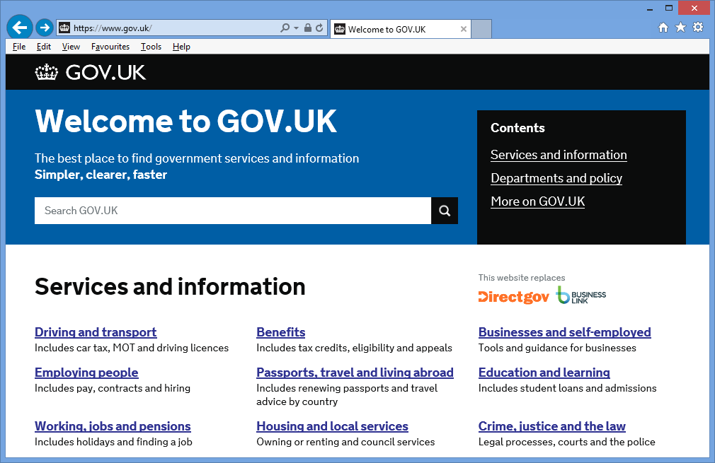
Web pages

Slide 8
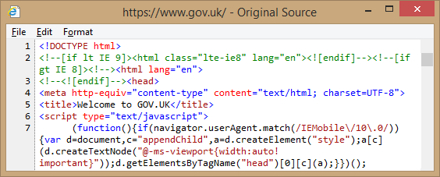
Web page code
You can look at the HTML code behind a web page (Ctrl + U or View, Source)
The first few lines of code behind this page look like this:

Slide 9

<Opening> and </Closing> tags
<holiday>
Swimming
Sandcastles
Sightseeing
</holiday>
Without the closing tag we would all be in a permanent state of ‘holiday’!

Slide 10
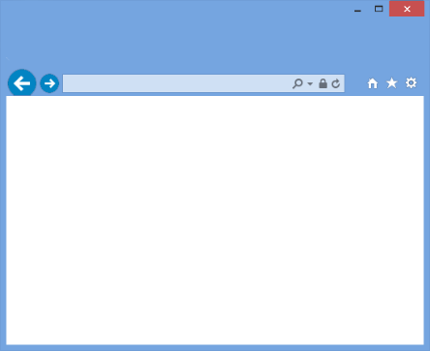
Parts of a Web Page
Websites are made up of a Head and a Body
Can you guess what any of the code lines do?
For example, look at line 5:
<title>Welcome to GOV.UK</title>
What might this do?
Head
Body

Slide 11
Editing HTML Code
Copy the Australia.html and Australia.jpg files to your own file area
Open Australia.html in a browser
Open the source code in Notepad
Make changes to the source code and Save
View the changes in a browser
Things to try changing:
Background and text colours
Font sizes
Width of the picture
Title and body text
Alignment
Links

Slide 12

Writing HTML Code
Copy the NewZealand.html and the NewZealand.jpg files to your own file area
Open the NewZealand.html file in a browser
Open the same file in a text editor such as Notepad or WordPad

Slide 13
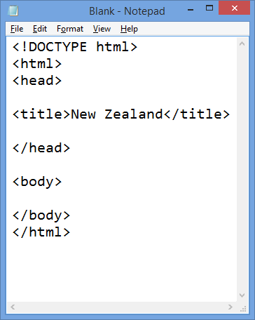
Writing HTML Code
Write a title in between the <title> and </title> tags
Save the webpage using File, Save or press Ctrl+S
Switch to the Browser and refresh or press F5.
View your changes

Slide 14
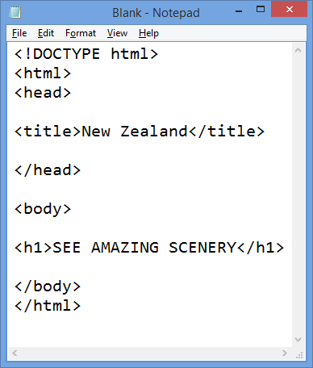
Adding a heading
After the <body> tag write <h1></h1>
In between the new heading tags, write some text
Save the html file and refresh the browser to view your changes

Slide 15
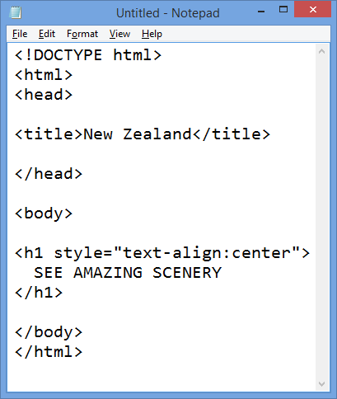
Changing the alignment
Inside the <h1> tag write
<h1 style="text-align:center">
Save and refresh the browser

Slide 16
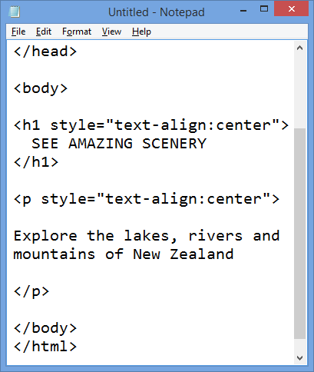
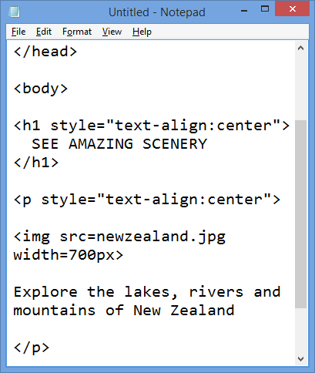
Adding text and images

Slide 17
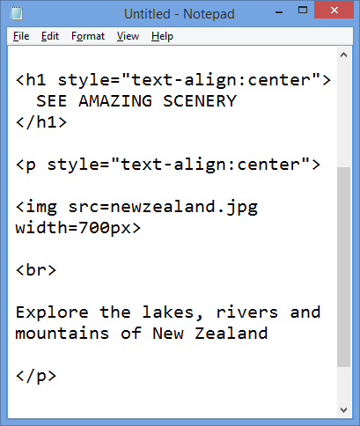
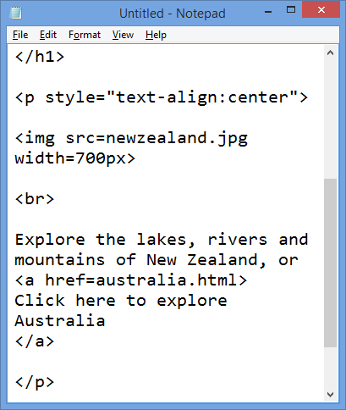
Adding breaks and links

Slide 18
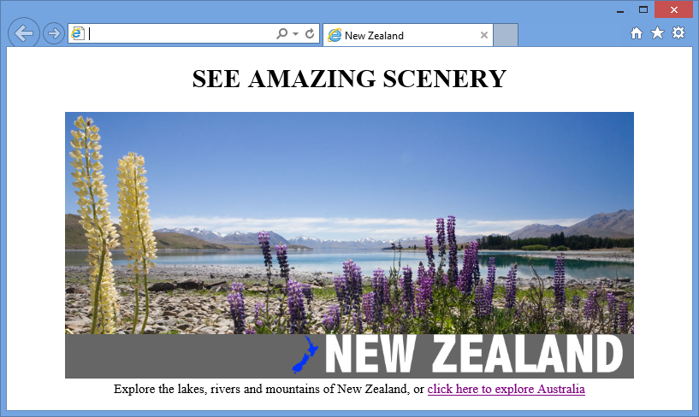
Your finished page

Slide 19
Your website
You are going to start designing and building your own website
You will continue building this website throughout the unit, as you learn new HTML, you can make your website more advanced.
First you will begin the design process. Complete the accompanying design worksheet, then start building your website!
Remember, there is nothing wrong with copying and pasting code from your current webpage to help you.

